Slide 1
Front-end web development
HTML AND CSS
Submitted By:-Krishant Chauhan
Course :- Bca
Sem:- 4
Roll no. :- 29
University Roll no. :- 1921085

Slide 2
HTML OverView
All of that is still quite a bit away!
For now we will start with Level One:
HTML Basics
Lists
Divs and Spans
Attributes

Slide 3
1 - HTML Basics

Slide 4
Lists

Slide 5
Let’s get all our information on our HTML page organized!
One way to do this is with a list.
HTML has two types of lists: ordered and unordered.
We can then add list elements to each!

Slide 6
Divs and Spans

Slide 7
However we won’t really be able to utilize them until we learn about CSS
Basically used in CSS .

Slide 8
Attributes

Slide 9
HTML Attributes allow us to add more information to HTML tags
This includes things such as adding a link or referencing an image

Slide 10
HTML Level Two

Slide 11
In this section will consist of:
Tables
Forms

Slide 12
Tables

Slide 13
Tables in HTML consist of several tags working together:
<table>
<thead>
<th>
<tr>
<td>

Slide 14
Forms Basics

Slide 15
Creating Forms in HTML revolves around the <input> tag.

Slide 16
Forms and Labels

Slide 17
The use of the label tag will allow you to add labels in front of an input in your HTML form.

Slide 18
Form Selections

Slide 19
Exploring the variety of input methods for forms, such as:
Radio Button (Linked)
Drop Down Menus
Text Area Inputs

Slide 20
CSS Level One

Slide 21
CSS stands for Cascading Style Sheets
CSS describes how HTML elements are displayed on a page
Styling can affect color, font, size, borders, and many more properties of HTML

Slide 22
Selectors

Slide 23
A major part of CSS is “selectors”
Selectors in general are used to target HTML elements that we want to style

Slide 24
So far we’ve only approached the idea of selecting HTML elements by their tag
But what if we only want to select subsets? Or select a single element?
That is where we can use selectors to clarify exactly what elements we want

Slide 25
We can use “ids” to target single elements
We can use “classes” to target groups of elements
We can also use combinations of selector tags to target certain combinations of elements

Slide 26
Specificity

Slide 27
Now, we will brieﬂy cover a CSS topic called “speciﬁcity”
Speciﬁcity deﬁnes the hierarchy of CSS styling, and what type of tags overrule others.

Slide 28
CSS Level Two

Slide 29
Here we will Learn about CSS by learning about Fonts and the Box Model

Slide 30
Here we will learn about font properties with CSS, such as size,weight, text alignment, etc.
We will also learn how to download and change fonts.

Slide 31
When dealing with fonts, we have to keep in mind that not every OS has every font!
We may need to provide the font for our website.

Slide 32
Because of this we will be exploring a few links:
OS support for certain fonts
Downloading fonts

Slide 33
BOX Model

Slide 34
The box model allows us to precisely dictate how we want HTML elements to look.

Slide 35
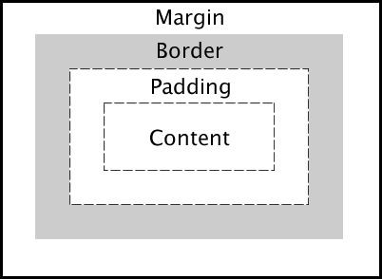
The basic box model looks like this:

Slide 36
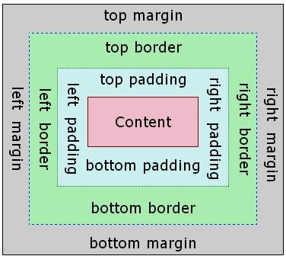
But you can also specify each side:

